Slide 1
Translation of Discoveries to Impact on Health
Elaine Collier, md
Senior advisor to director, NCATS
Vivo/scits 2014
August 7, 2014

Slide 2
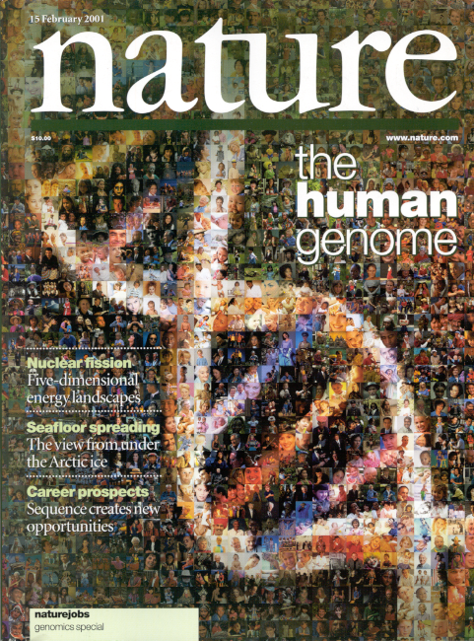
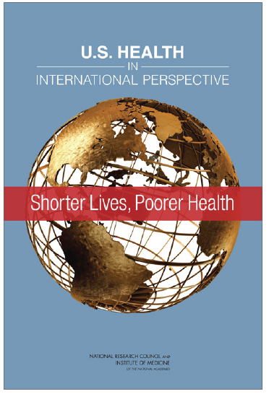
The Best of Times, the Worst of Times
Fundamental science unprecedentedly advanced, but:
Poor transition of basic or clinical observations into interventions that tangibly improve human health
Drug/device/diagnostic development system in crisis
Clinical trials system in crisis
Poor adoption of demonstrably useful interventions
People unhealthier and funders of biomedical research enterprise (public and private) impatient

Slide 3
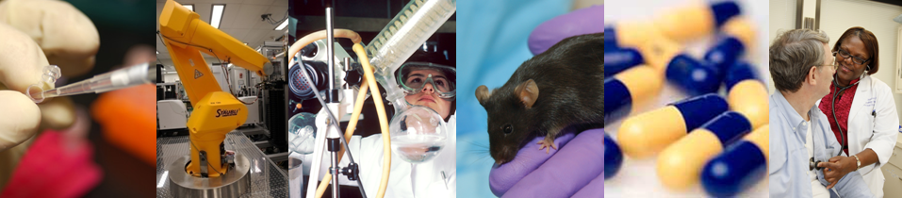
NCATS Mission
To catalyze the generation of innovative methods and technologies that will enhance the development, testing and implementation of diagnostics and therapeutics across a wide range of human diseases and conditions.
Notes:
NCATS is a catalyst for constructing an innovation highway for translation of health research.

Slide 4
NCATS Mission: an informal but important modification
To catalyze the generation of innovative methods and technologies that will enhance the development, testing and implementation of interventions that tangibly improve human health across a wide range of human diseases and conditions.
Notes:
NCATS is a catalyst for constructing an innovation highway for translation of health research.

Slide 5
Standard Model
Basic Laboratory
Research
Clinical
Research
Improved
Public
Health
Translational
Research
Population Research

Slide 6
The Way It Should Work
Basic Laboratory
Research
Patient-oriented
Clinical Research
Improved Public Health
Population-based Clinical Research
Clinical Trials

Slide 7
What is Translation?
Translation is the process of turning observations in the laboratory and clinic into interventions that improve the health of individuals and the public - from diagnostics and therapeutics to medical procedures and behavioral changes.

Slide 8
What is Translational Science?
Translational Science is the field of investigation focused on understanding the scientific and operational principles underlying each step of the translational process
NCATS studies translation as a scientific and organizational problem.

Slide 9
SO…what are some systemic issues on NCATS “to-do” list?
Translational Workforce
Processes and Methods
Data – Methods - Evidence Availability
Partnership and Collaboration

Slide 10

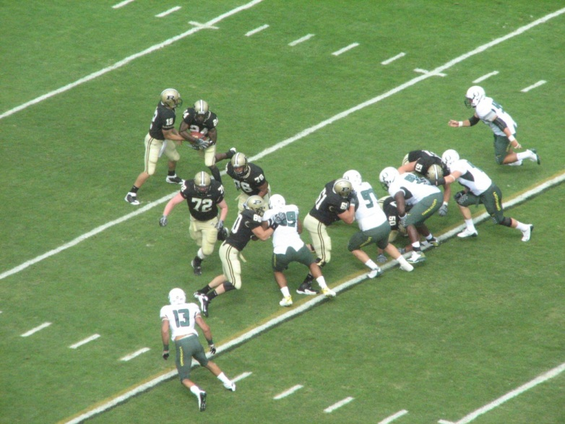
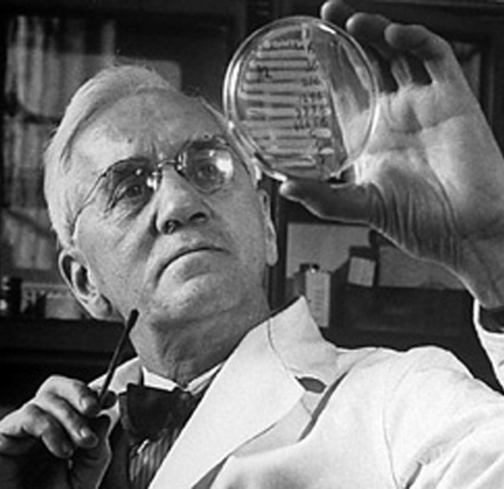
Translation is a team sport
Requires top performers with a wide variety of different expertise to work together to a common goal

Slide 11

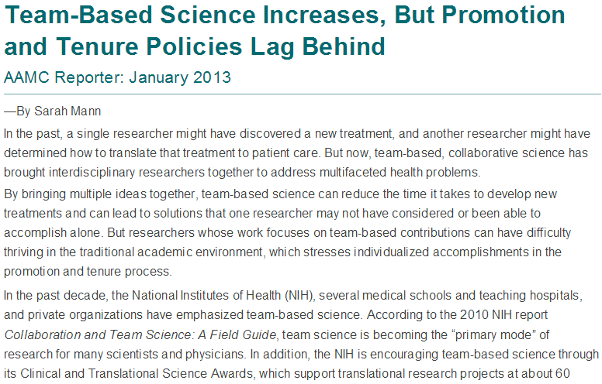
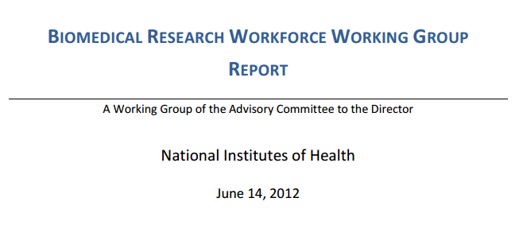
Career Path for Collaborative Researcher
Austin J Science 2014 344: 1422

Slide 12

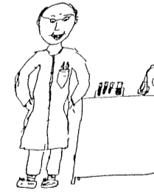

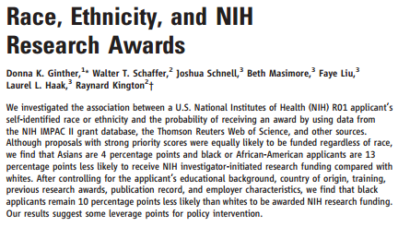
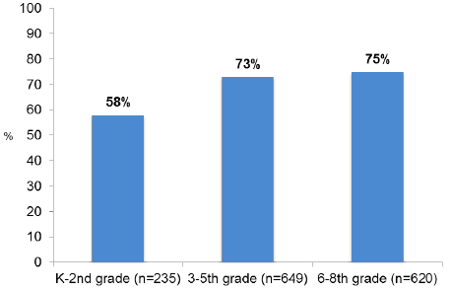
Diversity
Hannah Valantine, MD
NIH Chief Officer
Scientific Workforce Diversity
January 2014
Barman CR J Science Teacher Educ 1999 10 43-54
Ginther DK et al Science 2011 333:1015-1019

Slide 13
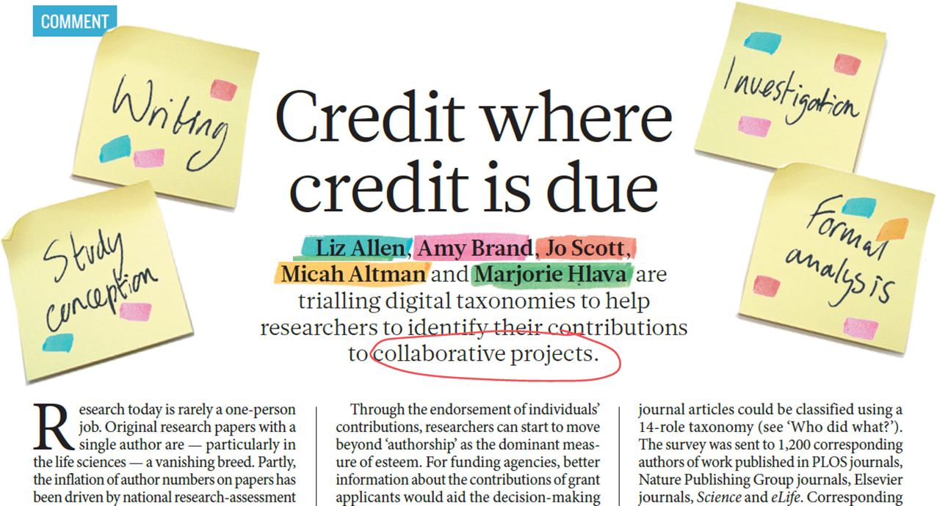
Recognition and Accountability
Allen L et al Nature 2014 508:312-3113

Slide 14
Processes and Methods

Slide 15
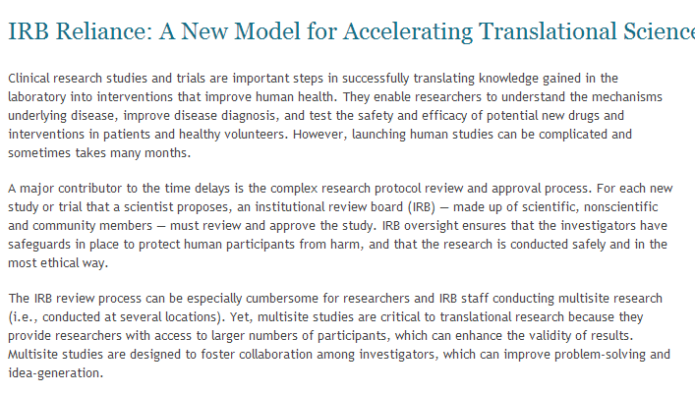
Single IRB for Multi-site Studies
ncats.nih.gov/news-and-events/features/irb-reliance.html

Slide 16
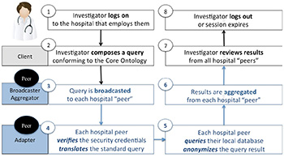
Recruitment for Clinical Studies
i2b2 Goes Viral: Open-Source Platform Enables Clinical Research
Sainani K Biomedical Computation Review 2014 Spring :7-8

Slide 17
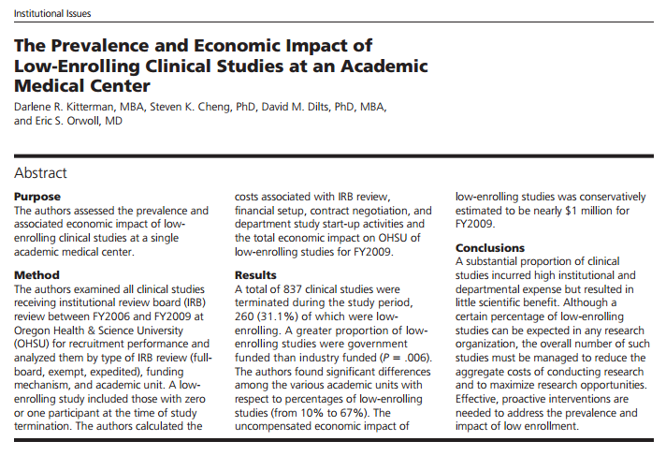
Low Enrolling Clinical Studies
31% of closed IRB approved studies enrolled zero or one participant!
Greater proportion of low enrolling studies were government funded
Kitterman DR et al Academic Med 2011 86: 1360-1366

Slide 18
Data-Methods-Evidence Availability

Slide 19
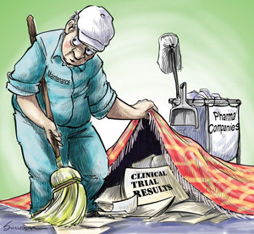
Clinical Trials Results not Available
From Harlan Krumholz

Slide 20
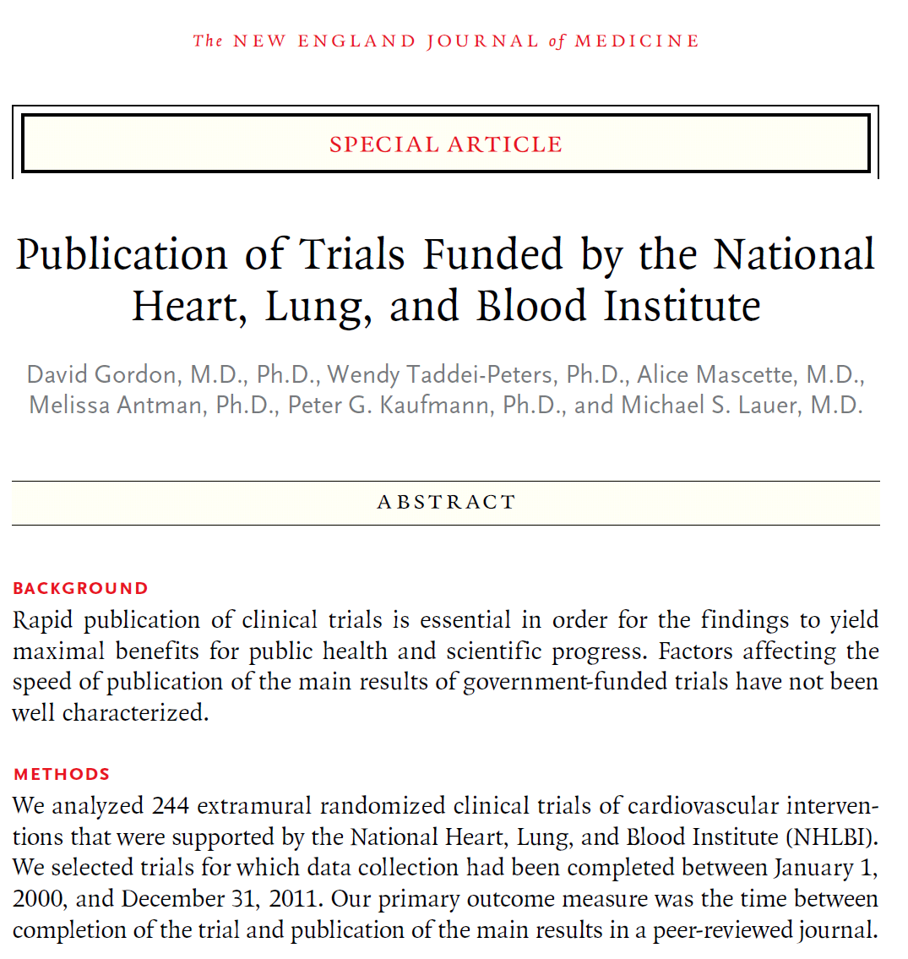
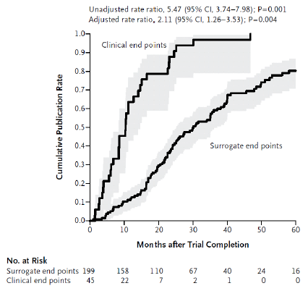
Timely Reporting of Results
Gordon D et al. NEJM 2013;369:1926-34

Slide 21
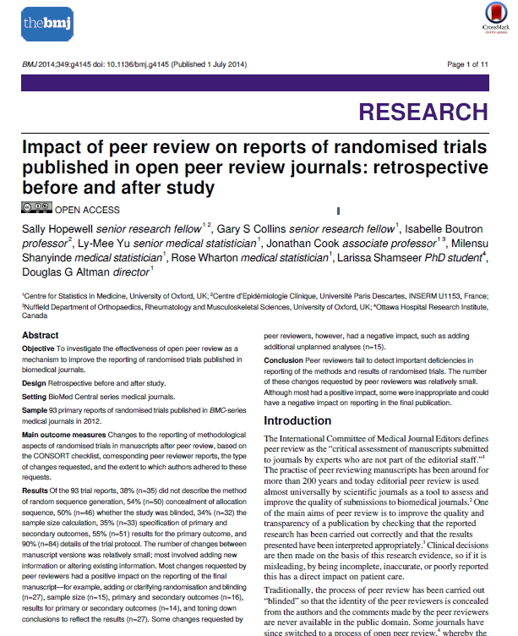
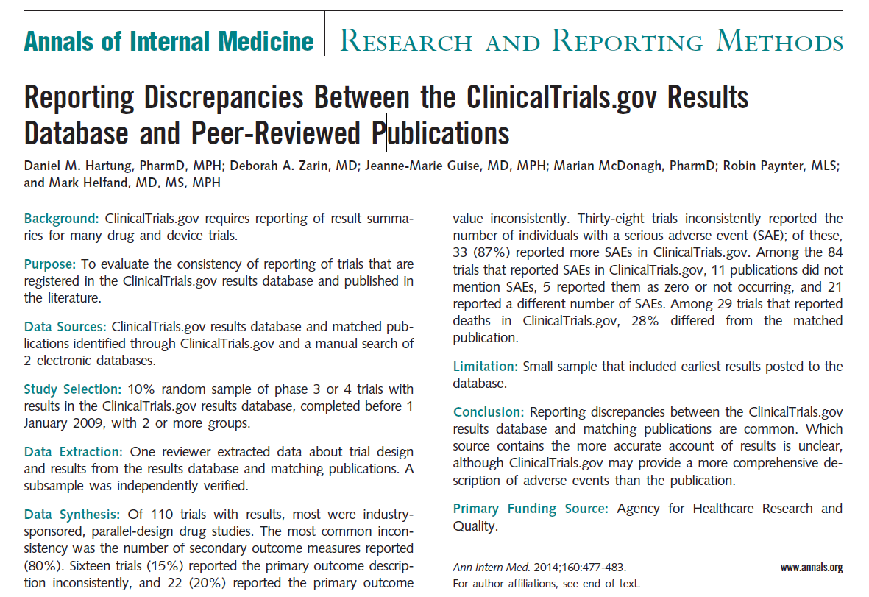
Selective Contradictory Incomplete Reporting
Hartung DM Ann Intern Med 2014 160:477-483
Hopewell S et al BMJ 2014 349: g4145

Slide 22
Collaboration and Partnership

Slide 23
Catalyzing Collaborations Within NIH
NCI
NHLBI
NIAID
OD
NIDCR
NEI
NIDA
NIA
CC
NIAMS
NIDDK
NLM
FIC
CIT
NHGRI
NCATS
NICHD
NIEHS
NINDS
NIBIB
NIAAA
NIDCD
NIMH
CSR
NCCAM
NINR
NIGMS
NIMHD

Slide 24
Catalyzing Collaborations Outside NIH
Academia
Biotech
Advocacy
Groups
NCATS
Pharma
Non-
Profits
FDA

Slide 25
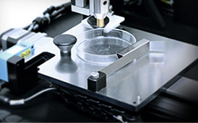
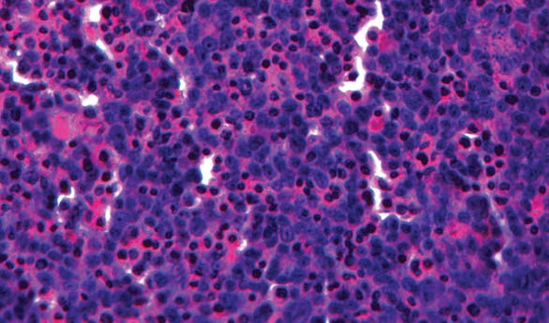
NCATS Case Study NCATS and NEI Partner with Organovo
Organovo, NCATS, and NEI collaborate on its NovoGen Bioprinting platform to create 3D, architecturally correct, functional living tissues
NCATS worked with NIH OD to include special IP and licensing clauses in a Research Collaboration Agreement
Collaboration working to develop a printable retina that can be used for screening drugs to treat eye diseases
Highly complementary to other NCATS’ programs - Tissue Chip and compound screening
Bioprinter
Liver tissue
(cross-section)
Notes:
NCATS suggested using a 3-way research collaboration agreement (RCA)
Organovo requested establishment of Joint Research Committee, IP and licensing terms

Slide 26



Developing new medicines for blood cancers: The Learning Collaborative
Bench-to-bedside translation in drug repurposing
National leadership in medicinal and pharmaceutical chemistry
Pharma experience
The
Learning
Collaborative™
Focus on rare and neglected diseases
Industrial scale HTS, cheminformatics, medicinal chemistry, drug development capabilities
Pharma experience
~400 active research projects
Worldwide network of blood cancer experts
Track record of commercial partnerships
Pharma experience

Slide 27
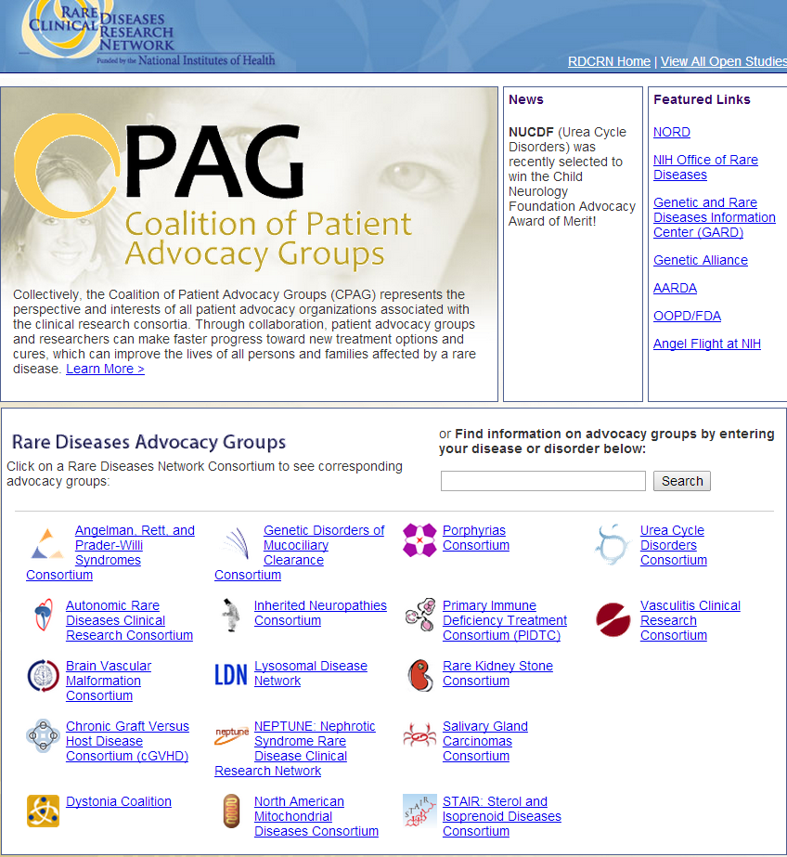
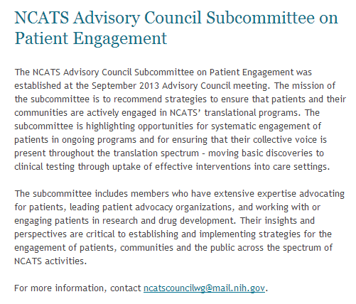
Patient Engagement
ncats.nih.gov/about/ncats-council/wgs/
engagement/patient-engagement.html
rarediseasesnetwork.org/CPAG/

Slide 28
Take-home messages
The opportunities (and needs) in translational science are huge and systematic, so require systematic solutions
The scale of the opportunities/needs requires transformational change to deliver logarithmic improvements
NCATS has just begun to transform itself and its programs to meet these opportunities and needs for the benefit of patients

Slide 29




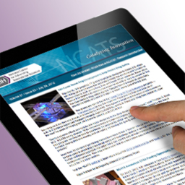
Learn More About NCATS
Website: www.ncats.nih.gov
Facebook: facebook.com/ncats.nih.gov
Twitter: twitter.com/ncats_nih_gov
YouTube: youtube.com/user/ncatsmedia
E-Newsletter: ncats.nih.gov/news-and-
events/e-news/e-news.html
Email us! info@ncats.nih.gov

